Slide 1
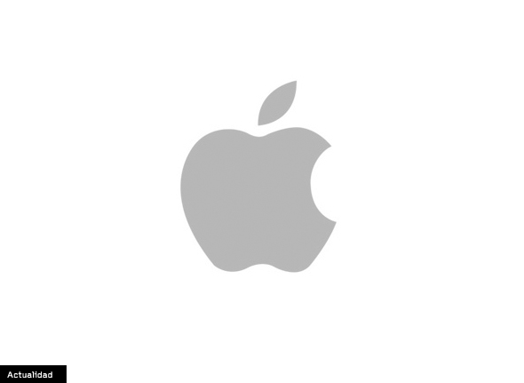

Apple.com
Design, Innovation & User Experience
Alberto Bolta Sanmateu
1º DAW

Slide 2

INDEX
Introduction
Description of the website
Target audience
Sections of the page
Layout & design
Elements
Possibilities for the user

Slide 3
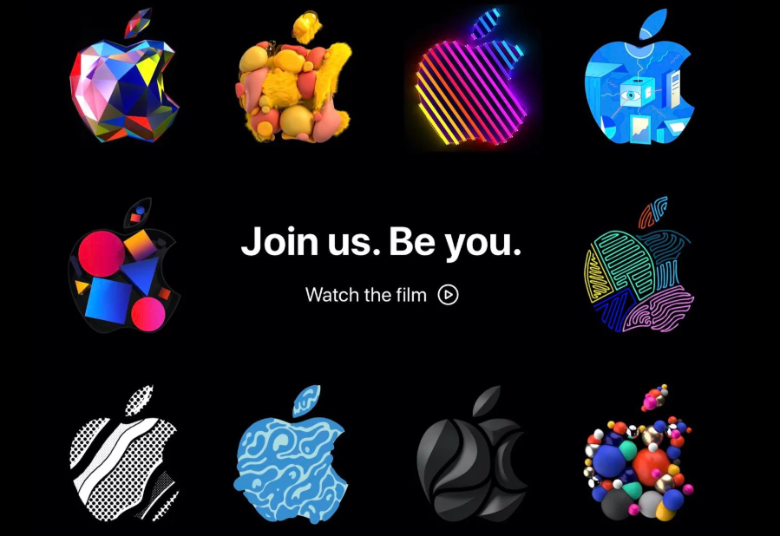
Why Apple’s Website Wins
Official platform for products, service and support.
Global benchmark in minimalist web desing.
Where technology meets intuitive user experience.
A visual storytelling platform for premium innovation.

Slide 4
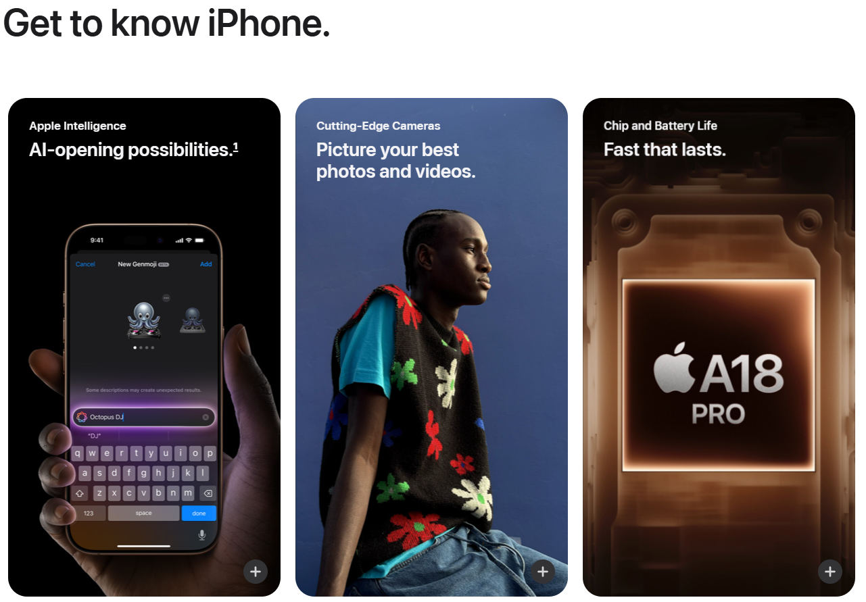
What is apple.com
Official hub for products, service and support.
Combines e-commerce,branding and customer care.
Design for discovery and seamless interaction.

Slide 5
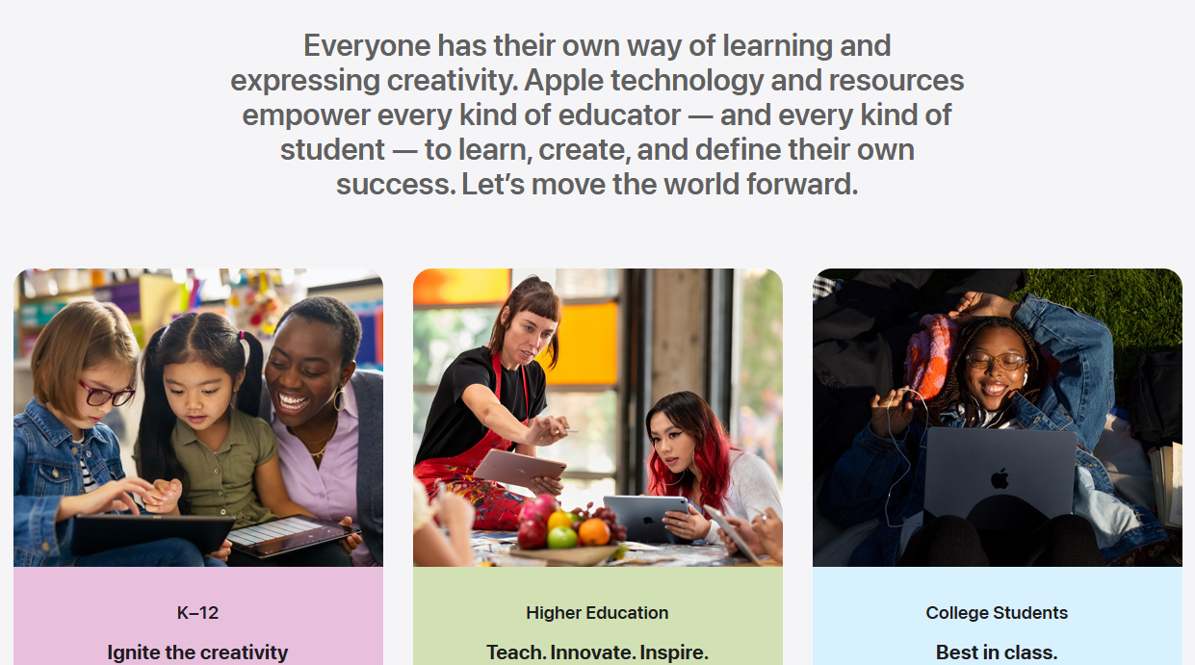

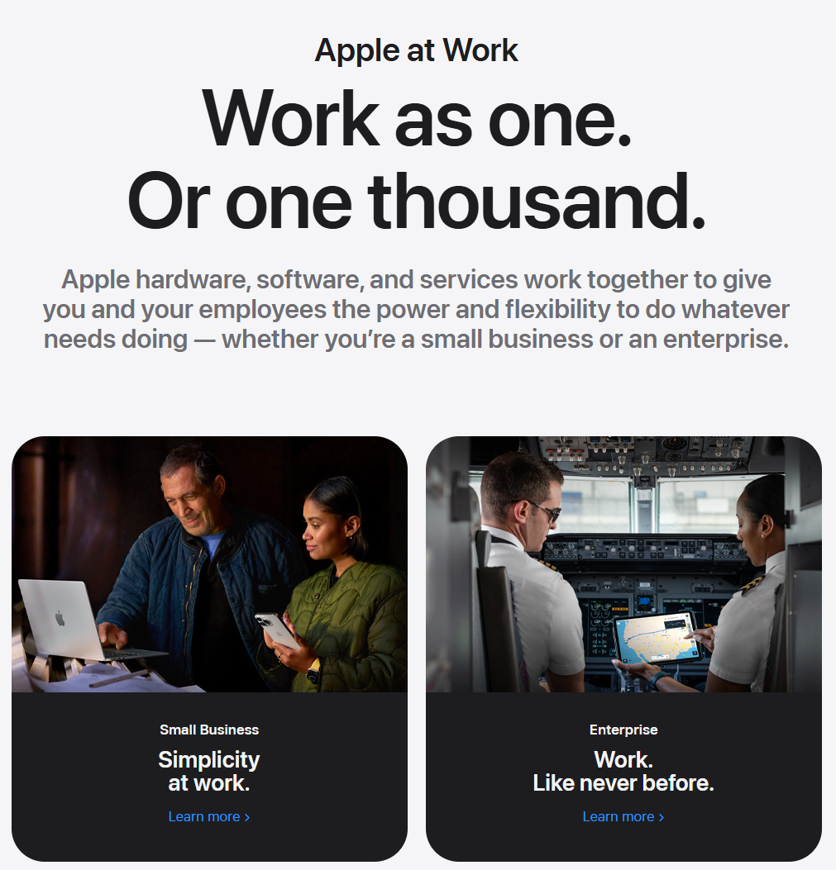
Who uses apple.com
Tech enthusiasts and early adopters.
Professionals (designers, developers, creatives).
Premium consumers valuing quality and ecosystem.

Slide 6
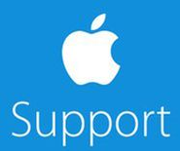



Exploring apple structure
Shop – Iphones, Mac’s, AirPods and more.
Support – Guides, repair and community.
Business/Education – Tailored solutions.
Explore – Products stories and Apple News.

Slide 7
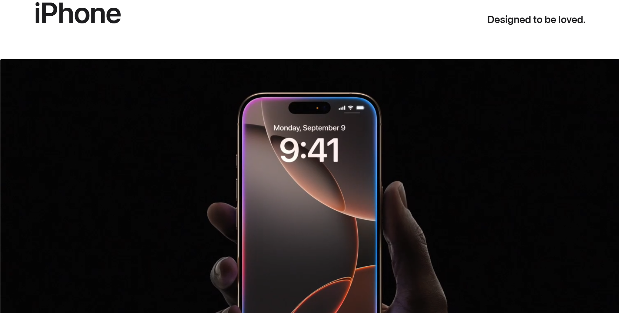
Less is More: Apple’s Design Secrets
White space dominance – Focus on products, not clutter.
SF Pro typography – Clean, readable, brand-consistent.
Grid-based visual hierarchy – Guides the eye naturally.

Slide 8
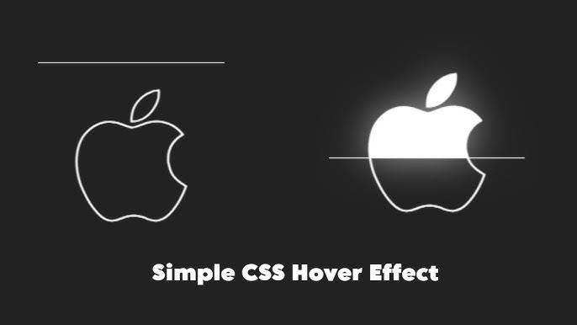
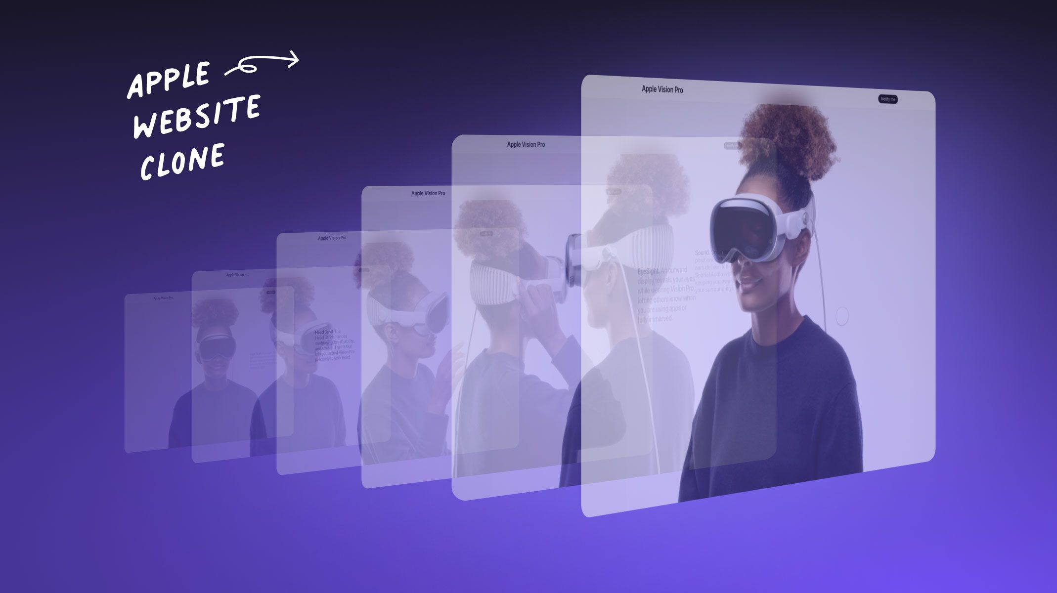
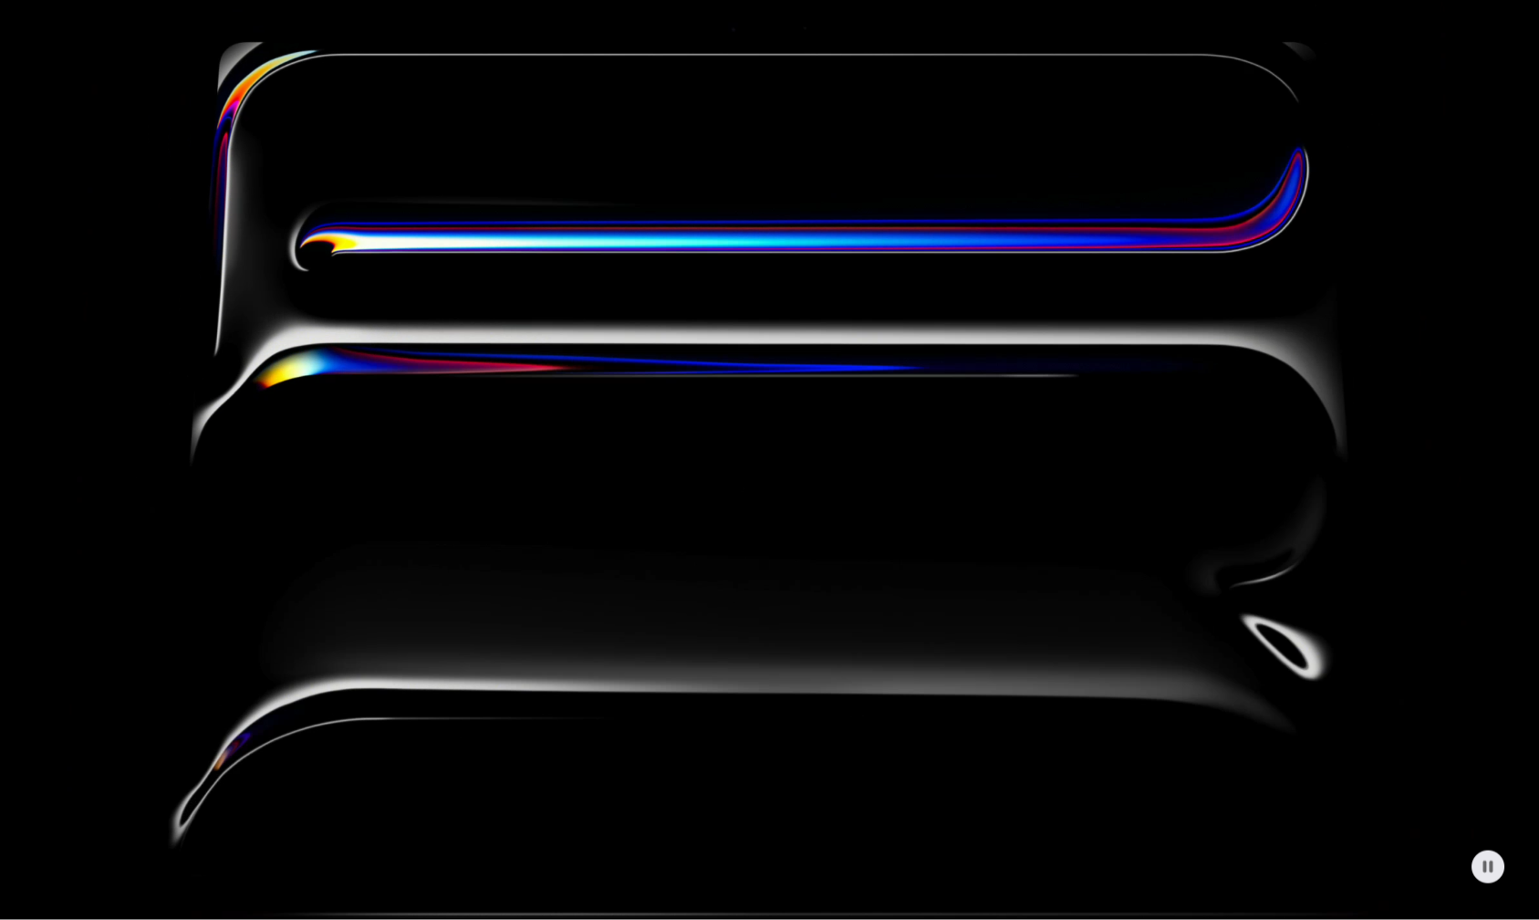
Beyond Static: Apple’s Interactive Magic
Hover-triggered animations – Buttons that breathe.
Cinematic auto-play video – Show, don’t tell.
Dynamic scrolling effects – Parallax Depth for storytelling.

Slide 9
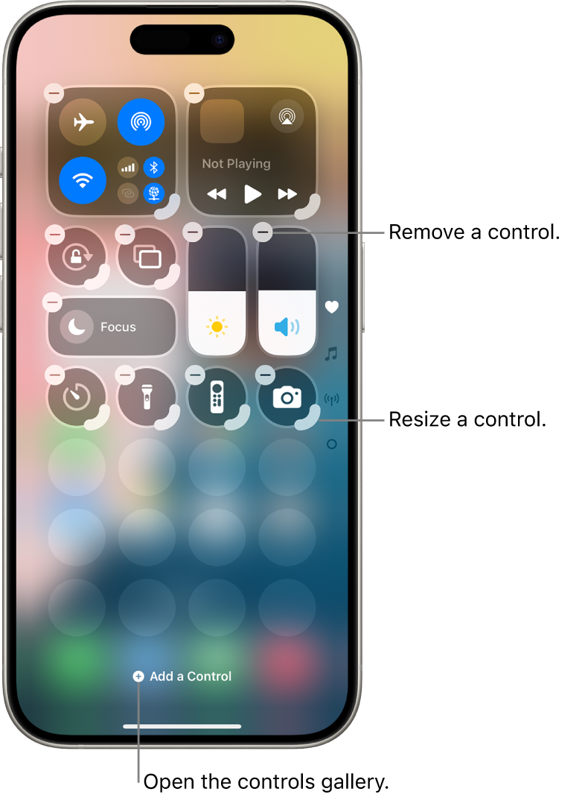
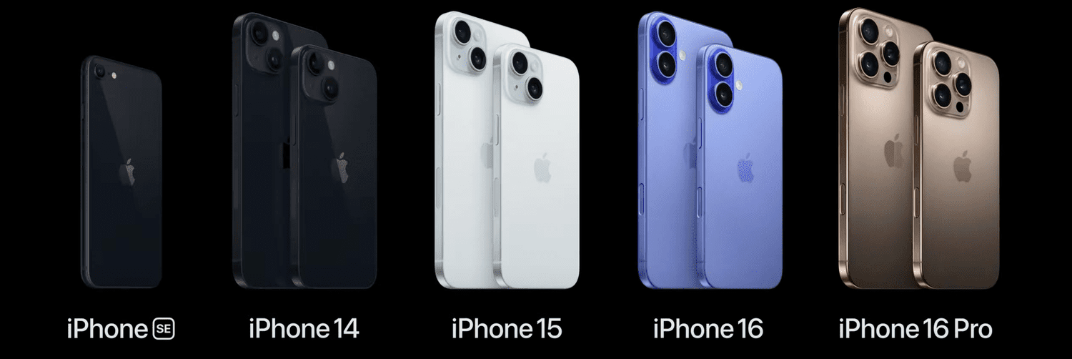
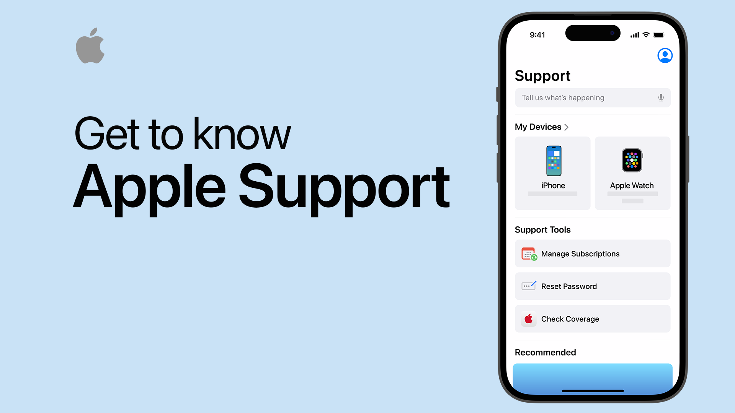
User Freedom: What Can You Do?
Compare models side-by-side.
Customize device in real-time.
Schedule in-store support.

Slide 10
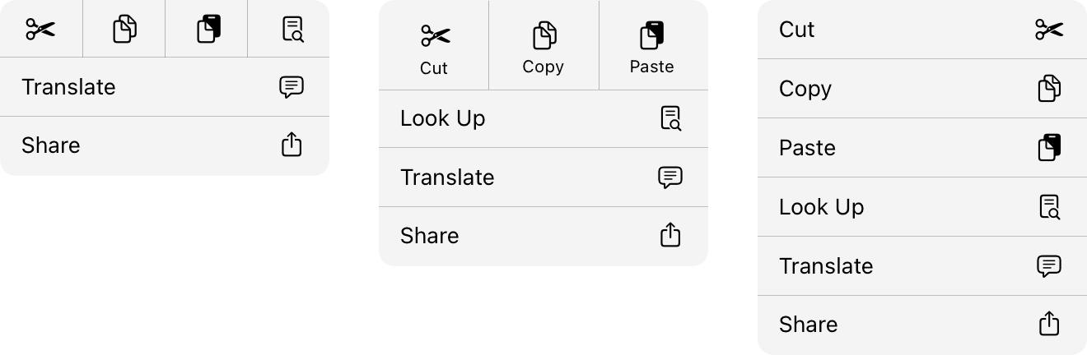
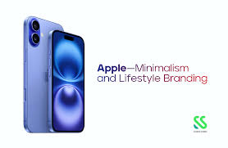
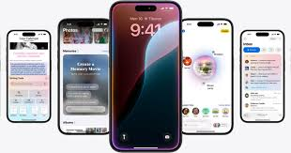
Why Apple Wins
Minimalism as a competitive advantage.
UX that anticipates user needs.
One tiny flaw: Key sections buried in menus.

